Slide 1
Smart Attendance System Using Face Recognition

Slide 2

Submitted By! Team 3
Ritik Agarwal 187151
Akhilesh Yadav 187205
Ankush Verma 187206
Bhashkarjya Nath 187210

Slide 3
PROBLEM STATEMENT
Let’s try to get to the crux of the problem.

Slide 4
Traditional student attendance marking technique is facing a lot of trouble. The face recognition student attendance system emphasizes its simplicity by eliminating classical student attendance marking technique such as calling student names or checking respective identification cards. There are not only disturbing the teaching process but also causes distraction for students during exam sessions. Apart from calling names, attendance sheet is passed around the classroom during the lecture sessions. Thus, face recognition student attendance system is proposed in order to replace the manual signing of the presence of students which are burdensome and causes students to get distracted in order to sign for their attendance.

Slide 5
INTRODUCTION
Let’s try to understand the project from scratch.

Slide 6
The main objective of this project is to develop face recognition based automated student attendance system. In order to achieve better performance, the test images and training images of this proposed approach are limited to frontal and upright facial images that consist of a single face only. The test images and training images have to be captured by using the same device to ensure no quality difference. In addition, the students have to register in the database to be recognized. The enrolment can be done on the spot through the user-friendly interface.

Slide 7
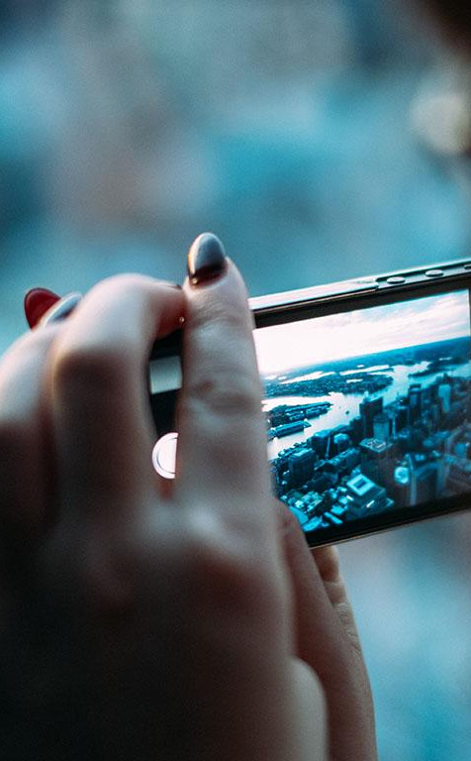
Flow of the project
.

Slide 8

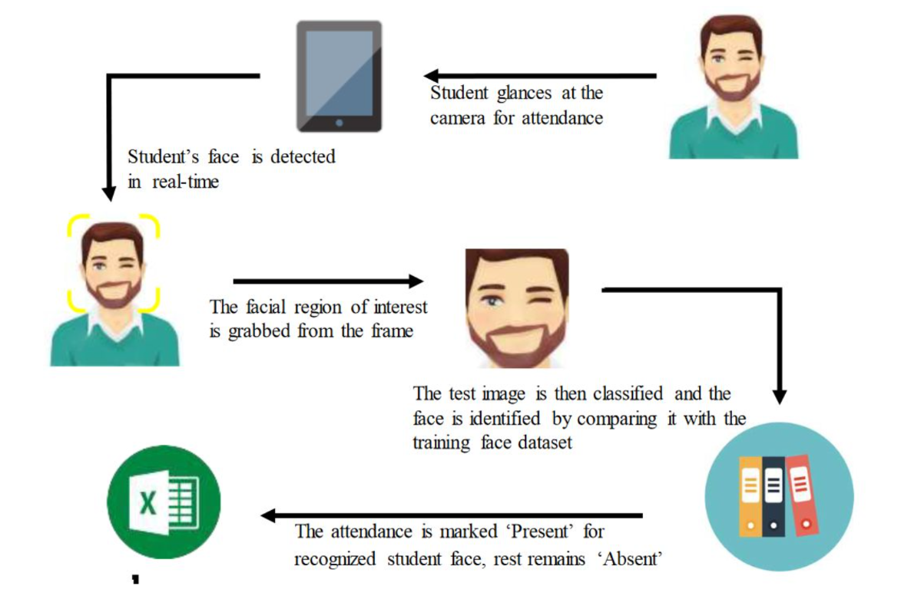

Slide 9
IMPLEMENTATION
Let’s focus our attention on understanding how the code is running.

Slide 10
Implementation Details Part 1.0
FINDING ALL THE FACES
We start by looking for faces in an image to start with making our image black and white as a result of color data isn’t required to go looking out for faces. Then we will investigate every single pixel in our image one at a time. For every single pixel, we might wish to appear at the pixels that directly encompass it.
POSING AND PROJECTING FACES
The webcam will capture the image and ask for the id of the student. The image would be converted to grayscale and then a rectangular box will appear covering the face. The data would then be inserted in the Training Image folder.

Slide 11
Implementation Details Part 2.0
Encoding Faces
We train our model during this method. About 100-200 images get captured and are stored in the database, which can be used to detect and recognize the person in the testing phase.
Finding the person’s name from the encoding
This step involves identifying the person in out database who has the closest measurements to our test image.
Find face in an image.
Analyze facial features.
Compare against known faces.
Make a prediction.
Recording Attendance
The face is detected by the following the previous steps and in the final step the face is recognized and the attendance is marked for the recognized person, along with a timestamp.

Slide 12
Attendance Table generated
Roll Number | Name of student | Date | Timestamp
187210 | Bhashkarjya | 05/04/2021 | 10:04:21
187206 | Ankush | 05/04/2021 | 10:30:22

Slide 13
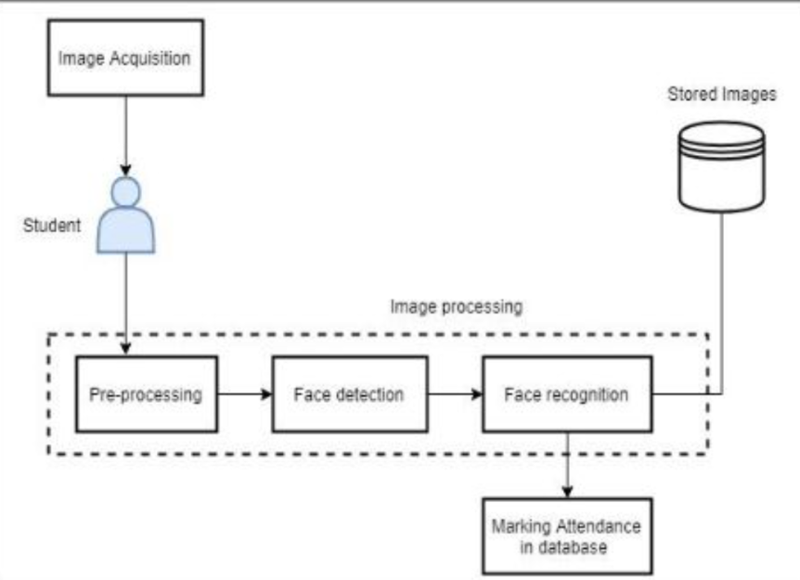
OUR PROCESS IS EASY
first
second
last

Slide 14
CONCLUSION!
The proposed algorithm is implemented in Python, utilizing the OpenCV face recognition framework for training and deploying the final models. We've also got a rough idea of how exactly the software is going to work, the steps involved, and the user interfaces. An attendance management system is a necessary tool for taking attendance in any environment where attendance is critical. The attendance system would be able to detect the faces in the image and compare it with the enrolled faces in the database. On identification of a registered student face on the acquired image collections, the attendance register is marked as present otherwise absent

Slide 15
Thank You !!

